Slide 1
Statistics for humanities researchers
Day 5
Breaking the linear model free of (some) assumptions

Slide 2

What now?
General linear model
Linear relation between IV and DV
Dependent variable = interval variable
Independence assumption

Slide 3
What now?
Generalized linear model
Quadratic, cubic, etc.
Logistic Regression
Poisson Regression
Generalized mixed effects linear model
Nested models
Cross-Nested models

Slide 4
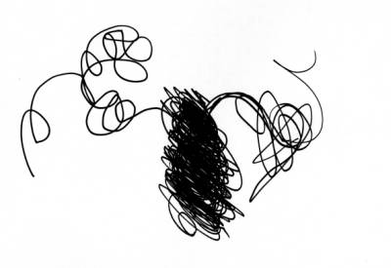
Out with linearity!
Part 1 – Children Learning Language

Slide 5
An Example
35 children with ASD and 32 typically developing controls matched by gender, SES and language production (starting around 2yo)
6 video-recorded visits every 4 months: 30 minutes of controlled playful activities with a parent
Videos were transcribed at word level and lexicon size automatically assessed
N.B. The exercise today is based on this corpus

Slide 6
Lexicon size
'right', 'is', 'it', 'one', 'four', 'go', 'open', 'what', 'slow', 'wee', 'no', "it's", 'wow', 'there', 'two', 'fast', 'build', 'goes', 'you', 'bye', 'whoa', 'ba', 'get', 'I', 'stop', 'kitty', 'ooh', 'gonna', 'let', 'sss', 'a', 'b', 'drum', 'oh', 'car', 'choo', 'yum', 'three', 'five', 'the'
Visit 1 ASD:
41 word types
Visit 6 ASD:
47 word types
'no,' 'set', 'do', 'mommy', 'it', 'pop', 'one', 'juice', 'goodnight', 'carrot', 'have', 'toys', 'go', 'open', 'blow', 'little', 'i', "Jack's", 'balloon', 'elephant', 'red', 'can', 'oh,', 'me', 'drink', 'that', 'bus', 'clue', 'hi', 'press', 'a', 'pull', 'c', 'daddy', 'look', 'mm', 'octopus', 'k', 'dog', 'phant', 'cat', 'turn', 't', 'the', 'more', 'biscuits'
'no,', 'saying', 'just', "don't", 'please', 'uh,', 'four', "won't", 'go', 'yes', 'fine', 'milk', 'sharks', 'now', "he's", 'thinking', 'watch', 'waiting', 'bug', 'to', 'only', 'going', 'choose', 'under', 'they,', 'over', 'take', 'real', 'do', 'them', 'good', 'get', 'read', 'stop', "driver's", 'me', 'know', 'they', 'not', 'one', 'him', 'name', 'knock', 'school', 'like', "Michael's", 'yeah', 'try', 'garage', 'penguins', 'she', 'have', 'went', 'out', 'mean', 'because', 'says', 'fish', 'some', 'back', 'sign', 'hair', 'touch', 'see', 'sure', "nothing's", 'are', 'forgot', 'star', 'chair', 'really', 'um', 'what', 'yes,', 'for', 'away', 'washed', 'yet', 'him,', "there's", 'goes', 'got', 'can,', 'red', 'uh', 'blow', 'think,', 'who', 'Michael', 'she,', 'learn', 'here', 'we', 'let', 'Margaret,', 'put', 'mmhm,', 'tub', 'come', 'throw', 'on', 'boop,', 'kids', 'anything', 'oh', 'many', 'am', 'count', 'keep', 'buckles', 'guy', 'stand', 'way,', 'learn,', 'or', "can't", 'does', 'fish,', 'mommy', 'bath', "m's", 'right', 'done', "fishy's", 'another', 'open', 'your', "doesn't", 'little', 'from', 'her', 'Margaret', "it's", 'there', 'three', 'frog', 'start', 'live', "we're", 'way', 'more', 'door', 'starfish', 'that', 'bus', "what's", 'huh', 'cant', 'idea', 'off', 'eat', "here's", 'he', "I'll", "they're", 'has', 'look', 'this', 'up', 'will', 'froggy', 'can', 'were', 'my', 'taking', 'and', 'gone', 'huh,', 'then', 'is', "didn't", 'it', 'sleeping', 'high', 'need', 'say', 'at', 'want', 'in', 'ready', 'sits', 'check', 'if', 'pink', 'again', 'anymore', 'no', 'set,', 'make', 'when', 'how', 'build', 'which', 'elephant', 'you', 'gets', 'ball', 'okay', 'I', 'gas', 'boing', 'here,', 'driver', "let's", 'nothing', 'see,', 'why', 'dolphins', 'a', 'rolls', 'get,', 'ew,', 'home', 'm', 'think', 'scoop', 'so', 'comes', 'time', "she's", 'the', "that's", 'its', 'balloon', 'snake'
'aa', 'cheese', 'all', 'oh,', 'eh', 'do', 'yea', 'ah', 'fish', 'yeah', 'juice', 'done', 'aw', 'in', 'Jane', 'yes', 'choo', 'wash', 'its', 'hmmm', 'hah', 'wee', 'no', 'wow', 'there', 'ma,', 'beep', 'paa', 'burp', 'eha', 'it', 'whoa', 'baba', 'oo', 'Alex', 'clean', 'wa', 'that', 'dow', 'ee', 'huh', 'kish', 'me', 'da', 'hmm', 'I', 'hm', 'baby', 'off', 'ha', 'ss', 'eat', 'is', 'he', 'a', 'ma', 'bap', 'oh', 'mm', 'meow', 'bow', 'um', 'roar', 'uh', 'ho', 'itz', 'the', 'my', 'page', "that's"
Visit 1 TD:
71 word types
Visit 6 TD:
226 word types

Slide 7
Try to look at the data
Download https://github.com/fusaroli/Stats4Humanities2016/blob/master/Day5/Day5Exercise.csv
Put it in your working folder
Load it
View(Data)

Slide 8
Plotting
Try plot the number of UniqueWordsChild by Visit
ggplot(Data,aes(Visit, UniqueWordsChild))+geom_point()

Slide 9
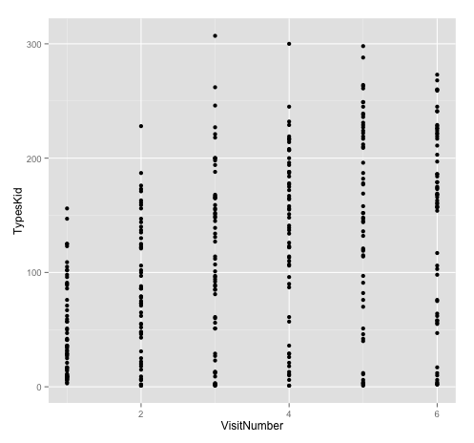

Slide 10
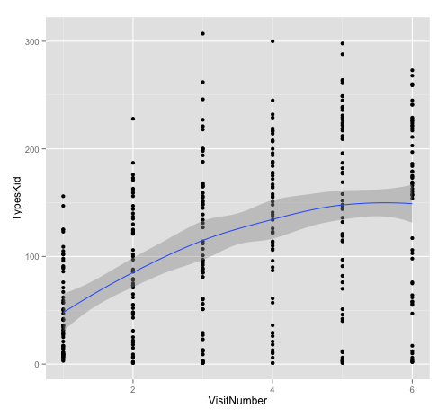
+geom_smooth()

Slide 11
The Linear Model
Y ~ b₀ + b₁*X₁ + error
plot1+stat_smooth(method = "lm")
Notes:
so this is how we expand this…
do this on the blackboard …. make a list with X1 = gender, and X2 = focus or no focus …and then 0 times, 1 times etc.

Slide 12
Linear

Slide 13
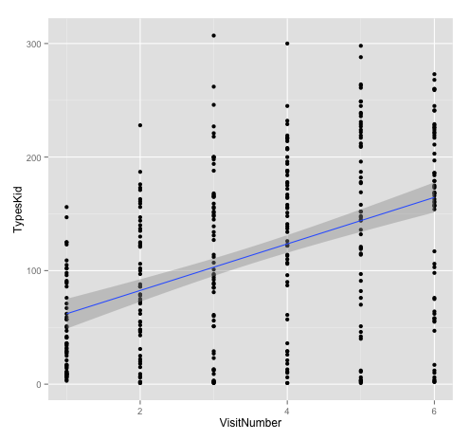
Actual data

Slide 14
The Quadratic Model
Y ~ b₀ + b₁*X₁ + b₂*X₁² + error
stat_smooth(method = "lm", formula = y ~ poly(x, 2))
Notes:
so this is how we expand this…
do this on the blackboard …. make a list with X1 = gender, and X2 = focus or no focus …and then 0 times, 1 times etc.

Slide 15
Quadratic

Slide 16
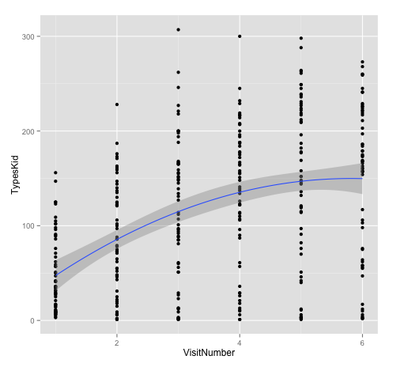

Slide 17
The Cubic Model
Y ~ b₀ + b₁*X₁ + b₂*X₁²+ b₂*X₁³ + error
stat_smooth(method = "lm", formula = y ~ poly(x, 3))
Notes:
so this is how we expand this…
do this on the blackboard …. make a list with X1 = gender, and X2 = focus or no focus …and then 0 times, 1 times etc.

Slide 18
Cubic

Slide 19


Slide 20
t²

Slide 21
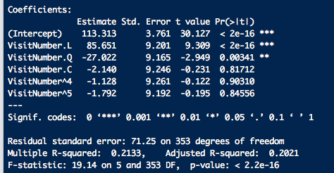
In practice (lazy solution)
Data$Visit=as.ordered(Data$Visit)
Model=lm(UniqueWordsChild~Visit,Data)

Slide 22
Less lazy
Data$Visit2=Data$Visit^2
Data$Visit3=Data$Visit^3
Model1=lm(UniqueWordsChild~Visit,Data)
Model2=lm(UniqueWordsChild~Visit+Visit2,Data)
Model3=lm(UniqueWordsChild~Visit+Visit2+Visit3,Data)
anova(Model1,Model2)
anova(Model2,Model3)

Slide 23
General
Linear Model
Generalized
Linear Model
Generalized Linear Mixed Model

Slide 24
General
Linear Model
Generalized
Linear Model
Generalized Linear Mixed Model

Slide 25
The Linear Model
“Response” ~ Predictor
Has to be continuous
Can be of any data type (continuous or categorical)
Notes:
not always “what you measure and what you manipulate” … or “what you observe and what you control” ...

Slide 26
The Generalized Linear Model
“Response” ~ Predictor
Can be of any data type (continuous or categorical)
Does not have to be continuous:
Binomial Data (Logistic)
Count data (Poisson)
Nominal (Multinomial)
Ordinal (Ordinal logistic)
etc

Slide 27
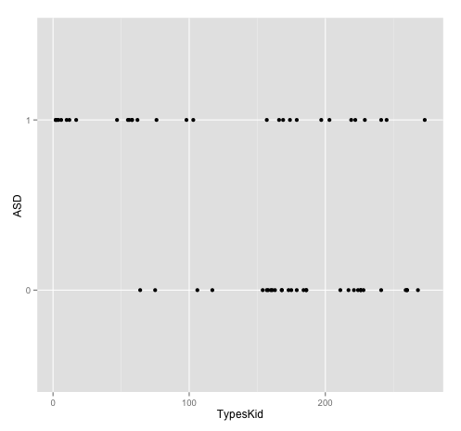
Is number of unique words at visit 6 a good predictor of autism?
Data6=Data[Data$Visit==6,]
ggplot(Data6,aes(UniqueWordsChild,ASD))+geom_point()

Slide 28
Is number of words at visit 6 a good predictor of autism?
Model=lm(ASD~UniqueWordsChild,Data6)
summary(Model)

Slide 29
Is this a good model??

Slide 30
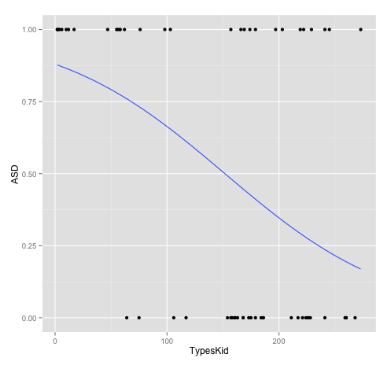
plot2=ggplot(Data[Data$VisitNumber==6,],aes(UniqueWordsChild,ASD))+geom_point()
plot2+stat_smooth(method="glm", family="binomial", se=FALSE)

Slide 31
The Linear Model
Y ~ b₀ + b₁*X₁

Slide 32
The Logistic Model
p(Y) ~ logit⁻¹(b₀ + b₁*X₁)

Slide 33
Log odds
= logit function

Slide 34
In R
Data1=Data[Data$Visit==6,]
glm(ASD ~ UniqueWordsChild,
Data1,
family=“binomial”)

Slide 35

Interpreting the model
Log odds for diagnosis when UniqueWordsChild = 0
Wait a sec for figuring out what it is!

Slide 37
Interpreting the model
For each increase in UniqueWordsChild by 1, how much the log odds decrease (= the slope)

Slide 39
Freaking Log Odds!
Exponentiate
Odds
Logits or “log odds”
Transform by inverse logit
Probabilities

Slide 40
Freaking Log Odds!
exp(-0.013)
Odds: 0.98
Logits or “log odds”
Transform by inverse logit
Probabilities

Slide 41
Odds
Numerator more likely
> 1
= event happens more often than not
< 1
Denominator more likely
= event is more likely not to happen

Slide 42
Odds
exp(-0.013)
0.98
< 1, therefore, with each increase of UniqueWordsChild by 1, the odds of observing case shrinks, though slowly

Slide 43
Freaking Log Odds!
exp(-0.013)
Odds: 0.98
Logits or “log odds”
Probabilities:
0.49675 (aka 0.00325)
inv.logit(-0.013)

Slide 45
= logit function
= inverse logit function

Slide 46
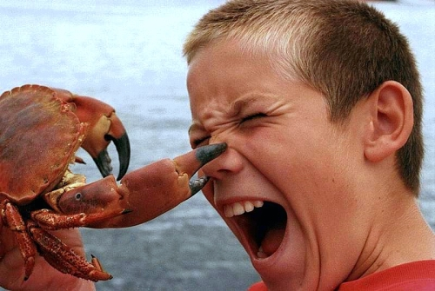
Mmh…
Can’t I use a general linear model on proportions, here?
Short answer:
No you can’t!
Notes:
…. the arcsine square root transform was primarily invented as an approximation in times where computing power was low

Slide 47
Averaging…
2/4 = 0.5 (or 50%)
30/60 = 0.5 (or 50%)
Notes:
data loss
- illustrate how proportions loose data by 2/4 … and 30/60 ….etc.

Slide 48
Moving further
Count data
Remember: the basic LM only applies to continuous outcome.
What if we want to predict the number of speech errors according to alcohol?
Notes:
counts = "the number of events happening in a predetermined time period"

Slide 51
Poisson Model

Slide 52
Poisson Regression
= generalized linear model with Poisson error structure and log link function

Slide 53
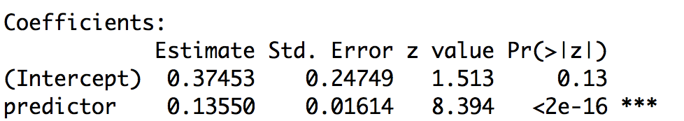
Poisson model output
exponentiate
log values
predicted mean rate

Slide 54
In R
glm(mybinary_response ~
predictor1 + predictor2,
mydataset,
family=“poisson”)

Slide 55
General
Linear Model
Generalized
Linear Model
Generalized Linear Mixed Model

Slide 56
= “Generalizing” the General Linear Model to cases that don’t include continuous response variables (in particular categorical ones)
= Consists of two things: (1) an error distribution, (2) a link function
Generalized
Linear Model

Slide 57
= “Generalizing” the General Linear Model to cases that don’t include continuous response variables (in particular categorical ones)
= Consists of two things: (1) an error distribution, (2) a link function
Logistic regression: Binomial distribution
Poisson regression:
Poisson distribution
Logistic regression: Logit link function
Poisson regression:
Log link function

Slide 58
= “Generalizing” the General Linear Model to cases that don’t include continuous response variables (in particular categorical ones)
= Consists of two things: (1) an error distribution, (2) a link function
Logistic regression: Binomial distribution
Poisson regression:
Poisson distribution
lm(response ~ predictor)
glm(response ~ predictor, family=”binomial”)
glm(response ~ predictor, family=”poisson”)
Logistic regression: Logit link function
Poisson regression:
Log link function

Slide 59
Non-continuous Data
Dichotomous
Count
Logistic Regression
Poisson Regression

Slide 60
Logistic Regression
= generalized linear model with binomial error structure and logistic link function

Slide 61
Poisson Regression
= generalized linear model with Poisson error structure and log link function

Slide 62
General Linear Model
= generalized linear model with normal error structure and identity link function

Slide 63
General structure
Linear Model continuous ~ any type of variable
Logistic Regression dichotomous ~ any type of variable
Poisson Regression count ~ any type of variable

Slide 64
Breaking free of independence

Slide 65

Data is hierarchical
Class 1
Class 2

Slide 66
Data is hierarchical
Class 1
Class 2

Slide 67

Data is hierarchical

Slide 68

Data is hierarchical
Intraclass Correlation
Notes:
school district…

Slide 69
Number of
Words
Visits over Time

Slide 70
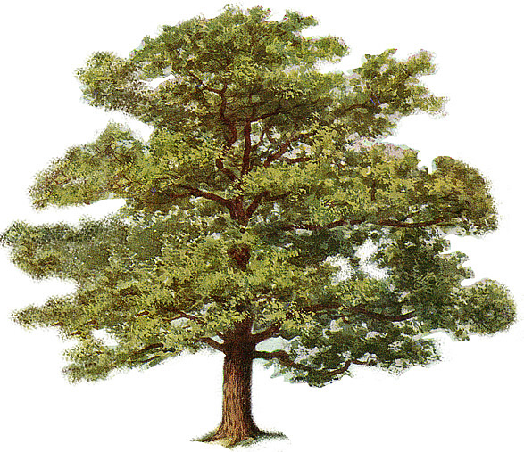
Interpretational Problem:
What’s the population for inference?

Slide 71

Violating the independence assumption makes the p-value…
…meaningless

Slide 72
All tests assume independence
You can’t get away from assuming independence; there’s no escape from it
The independence assumption is the most important assumption of all statistical tests – its violation results in meaningless statistics

Slide 73
General
Linear Model
Generalized
Linear Model
Generalized Linear Mixed Model
Adding RANDOM effects

Slide 74
Important terminology
assumed to be constant across experiments
Structural Part
Stochastic Part
“Fixed-effects factors are those in which the populations to which we wish to generalize are precisely the levels represented in our analysis.”
Fixed effect Random effect
- repeatable - non-repeatable
- systematic influence - random influence
- exhaust the population - sample the population
- generally of interest - often not of interest
- can be continuous - have to be categorical or categorical
Notes:
- you COULD call it Signal / Noise (it’s the basic general idea) … better call it “Structural Part” / “Stochastic Part” of the model

Slide 75
Child as a fixed effect?
NO… why:
➔ not repeatable
➔ not systematic
➔ often, not of interest
➔ small subset of population

Slide 76
Visit as a fixed effect?
Yes… why:
➔ repeatable
➔ systematic
➔ of interest
➔ “exhausts the population”

Slide 77
Random intercepts
_{versus}
Random slopes

Slide 78
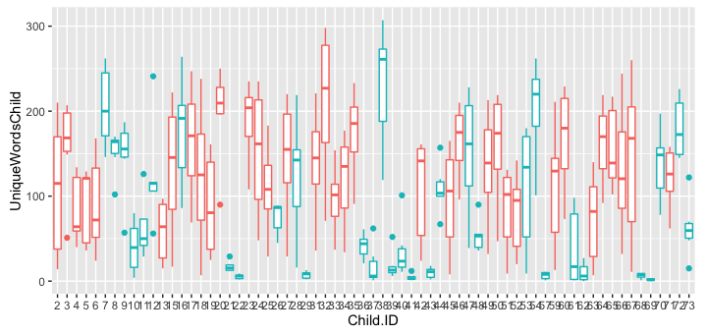
Random intercepts
What does it mean?
Data$Child.ID=as.factor(Data$Child.ID)
Data$ASD=as.factor(Data$ASD)
p1=ggplot(Data,aes(x=Child.ID,y=UniqueWordsChild))+geom_boxplot(aes(colour=ASD))

Slide 79
What does it mean?
Some kids are talkers, some kids are Danes-like (their “intercepts” for word types are different)

Slide 80
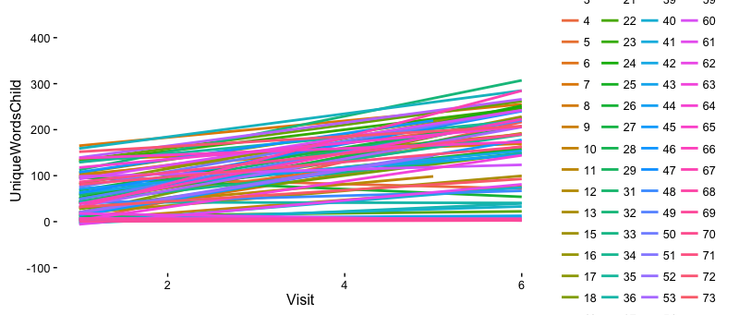
Random slopes
What does it mean?

Slide 81
What does this mean?
Some kids are fast learners, some do not develop.

Slide 82
Random intercept vs. slope models
Random intercept model
= the fixed effect is evaluated against an error term that captures subject- or item-specific variability in the response
Random slope model
= the fixed effect is evaluated against an error term that captures subject- or item-specific variability in how the fixed effect affects the response
In R: (1|Child.ID)
In R: (1+Visit|Child.ID)

Slide 83
Random intercepts
Word Types
Visit Number
Notes:
EACH LINE REPRESENTS A SUBJECT

Slide 84
Random intercepts and slopes
Word Types
Visit Number
Notes:
EACH LINE REPRESENTS A SUBJECT

Slide 85
An example
Model=lm(UniqueWordsChild ~ Visit, Data)
library(lme4)
Model1 =lmer(UniqueWordsChild ~ Visit + (1|Child.ID),Data)
Model2 =lmer(UniqueWordsChild ~ Visit + (Visit|Child.ID) ,Data)

Slide 86
Cross-Nested
Model3 =lm(Data, UniqueWordsChild ~ Visit+ (Visit|Child.ID)+(1|Experimenter)
Model4 =lm(Data, UniqueWordsChild ~ Visit+ (Visit|Child.ID)+(Visit|Experimenter)

Slide 87
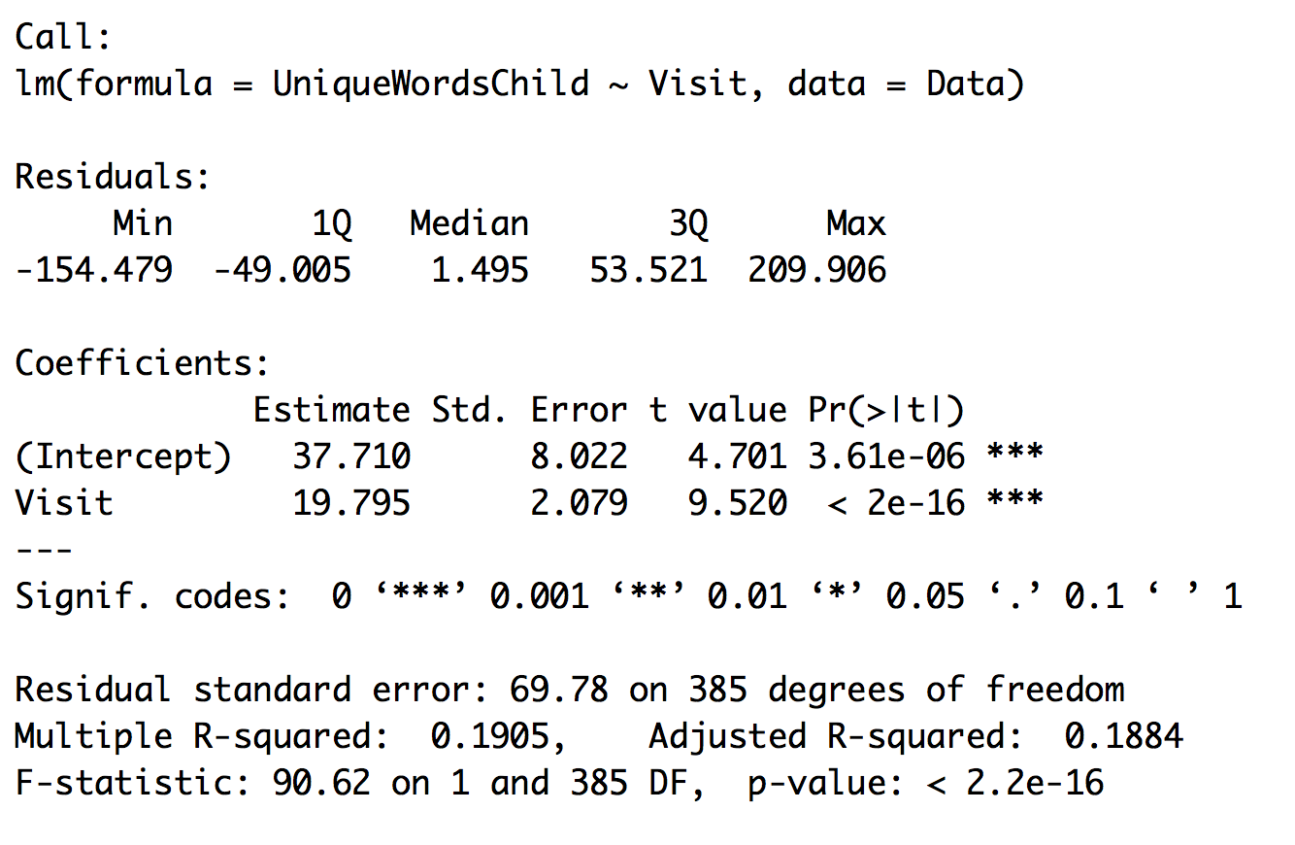
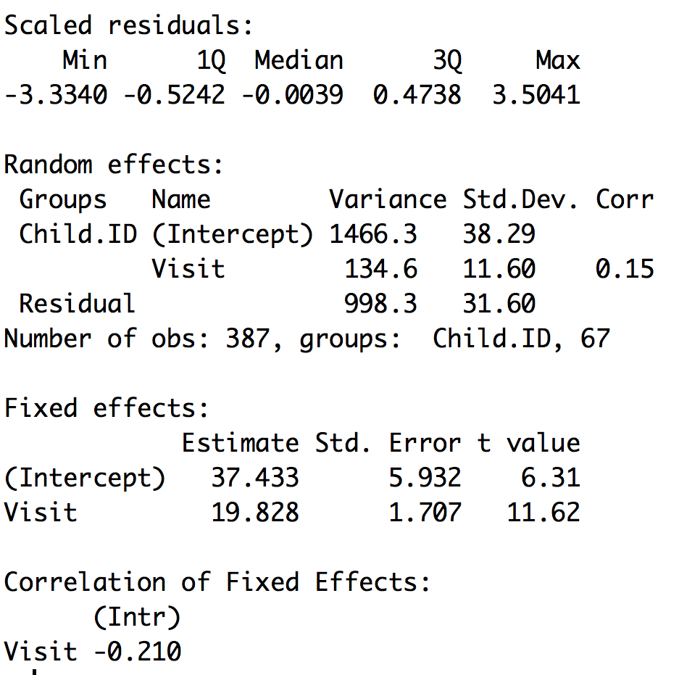
Reading the output

Slide 88
Calculating p-values, R² and individual slopes
Library(lmerTest)
Then run your model
library(MuMIn)
R2=r.squaredGLMM(Model2)
coef(Model2)

Slide 89
What now?
Get on with your data!
Don’t stop learning!
Coursera Data Science Specialization
Warning: “R programming” is really booooooring
Warning: “Biostats” is too nerdy
A. Gelman:
Data Analysis Using Regression and Multilevel/Hierarchical Models

Slide 90
Testing Assumptions
#Testing for influential observations
alt.est <- influence(model, group="Subject")
SigChange <- sigtest(alt.est, test=-1.96)$Schizophrenia
if ('TRUE' %in% SigChange$Changed.Sig){
cat("WARNING! The model is not robust!")
match('TRUE',SigChange$Changed.Sig)
} else { cat('All good the model is robust')}
plot(model0)
qqnorm(resid(model0))
hist(resid(model0))

